Slide 1

2026 Benefits Review
Reviewing benefits for FY27

Slide 2
Our Goals for You Today
Gain a clearer understanding of the benefits available to you during open enrollment.
Review your current benefits and understand any changes that may be occurring.
Discover new benefits that you might not have known about previously.

Slide 3

Which benefit do you value the most?

Slide 4
Today’s Topics
Retirement Plans (Mandatory and Voluntary)
GIC Insurance (Health, Optional Life, Long Term Disability)
Annual Enrollment Period
Mass4YOU - Employee Assistance Program (EAP)
Dental and Vision
Flexible Spending Accounts (Health and Dependent Care)
Leave Accruals/Paid Time Off
Tuition Remission
Employee Discounts

Slide 5
Retirement Plans - Mandatory
COMMONWEALTH OF MASSACHUSETTS EMPLOYEE RETIREMENT PLANS
Retirement Plan Name | Abbreviation | Description | Eligibility
Massachusetts State Employees’ Retirement System | MSERS | Defined benefit plan that provides predictable & guaranteed income (benefits calculated using a formula) | Classified Employees, Faculty, Unit Professionals and Non- Unit Professionals
Optional Retirement Program | ORP | Defined contribution plan that provides income based on the investment performance of your individual account balance, which you decide how to invest | Faculty, Unit Professionals, Non-Unit Professionals
Omnibus Budget Reconciliation Act | OBRA | Massachusetts Deferred Compensati on Smart Plan | Part time employees*
*Exemptions: Already paying into MSERS or ORP/Full time student For additional information, visit these websites:
MSERS: www.mass.gov/retirement
ORP: www.mass.edu.forfacstaff.orp
SMART Plan: www.mass-smart.com

Slide 6
Retirement Plans – Voluntary
Plan Name | Abbreviation | Administered by | Description | Eligibility
Tax Sheltered Annuity Plan | TSA – 403b | MA Department of Higher Education | Employees may contribute to tax sheltered annuities through (3) plan providers. | All employees
457 Deferred Compensation Plan – SMART Plan | 457b | Empower Retirement | Contributions can be made pre-tax or ROTH through bi-weekly payroll deductions. Contributions are invested based on the employee’s preferences, with flexible fund allocation options. | All employees
Massachusetts 403b Supplemental Retirement Plan - Department of Higher Ed: www.mass.edu
TSA – 403b has three plan providers to choose from: Corebridge, TIAA, and Fidelity.
Massachusetts SMART Plan 457(b) - User login | MA SMART Plan

Slide 7

GIC Insurance
Health Insurance, Life Insurance, Long Term Disability Administered by the Group Insurance Commission (GIC)
www.mass.gov/gic

Slide 8

Annual Enrollment: April 1, 2026 – May 1, 2026
You may only enroll in or change your health plan during this open enrollment
All changes/enrollments must be submitted no later than May 1, 2026.
Any elections made during open enrollment will become effective on: July 1, 2026.
After reviewing your options, if you wish to keep your current GIC benefits, no action is required, and your benefits will remain in place at the new rates effective July 1, 2026.
If you experience a qualifying event outside of open enrollment, you will have 60-days from the event to make changes to your insurance.

Slide 9
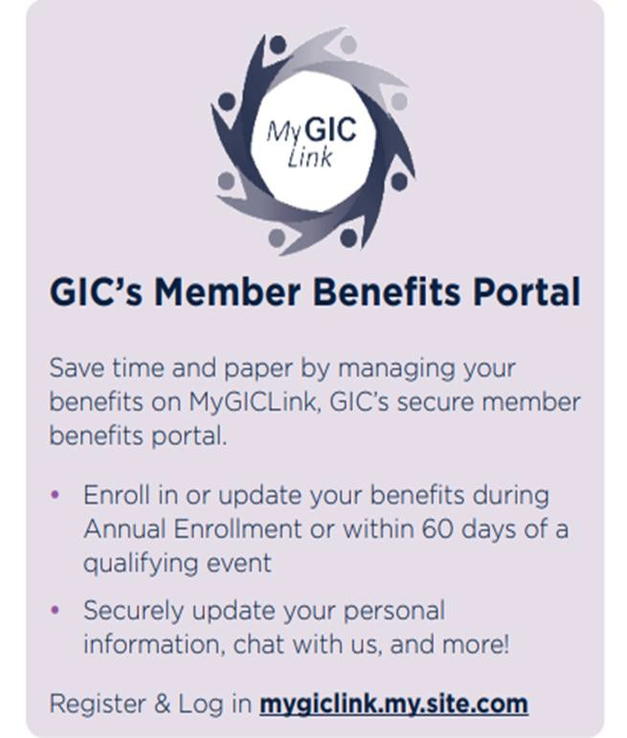
GIC’s Member Benefits Portal
Register and Log In here: Login | MyGIC Link
Notes:
If you currently not registered for the portal, please reach out to me and let me know.

Slide 10

FY2027 GIC Benefits Decision Guide
Check out the Benefits Decision Guide for employees, Retirees & Survivors: 2026–2027 BENEFITS GUIDE

Slide 11
FY2027 GIC Insurance Updates & Reminders
Rate & Tier Changes: Please review all plans for the current rate changes. Contact your health and other insurance plans about tier changes, network coverage, providers, drug tiers, wellness benefits, and more.
GLP-1 Medication Coverage: coverage for GLP-1 medications prescribed for the treatment of obesity, under GIC health plans, will discontinue on June 30, 2026.
Flexible Spending Account: New administrator, Ameriflex. Ameriflex will also administer the current plans grace period from July 1, 2026 - September 15, 2026) and any claims filed after July 1, 2026.
Important Reminders: Bristol does not participate in the Dental and Vision plans offered in the Benefit Decision Guide for active employees. Coverage is provided through separate administrators based on employee classification.
  Hinge Health: Available at no cost to members and dependents who are enrolled in GIC health coverage, Hinge Health gives you the tools to stay healthy, help manage back and joint pain, recover from injuries, prepare for surgery, and more. This program uses personalized plans, 15-minute sessions and one-on-one support to help improve your health. Learn more at: Commonwealth of Massachusetts and Hinge Health
Notes:
When checking provider coverage and tiers; be sure to specific the health insurance plans full name: like “Harvard Pilgrim Explorer” or “Harvard
Pilgrim Quality,” not just the health carrier name such as “Harvard
Pilgrim Health Care.”
Hinge Health:
As the GLP-1 prescription drug landscape continues to evolve, members are encouraged to stay informed. For the most up-to-date information, please visit the GIC’s website at mass.gov/gic.
New Flexible Spending Account administrator, Ameriflex.

Slide 12
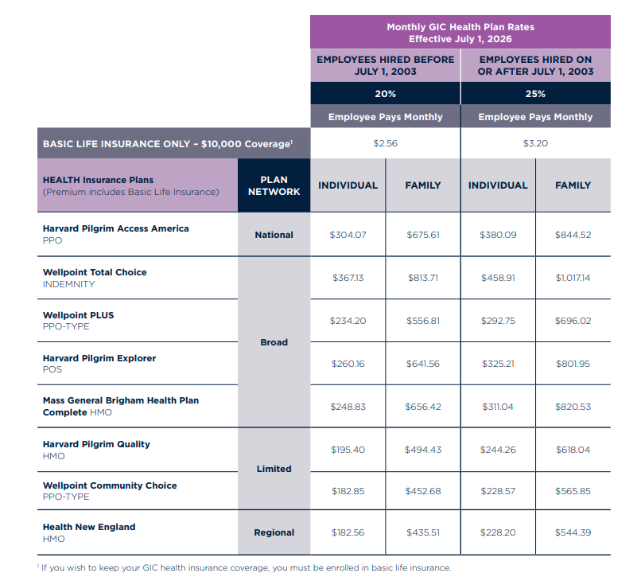
Health Insurance Rates

Slide 13
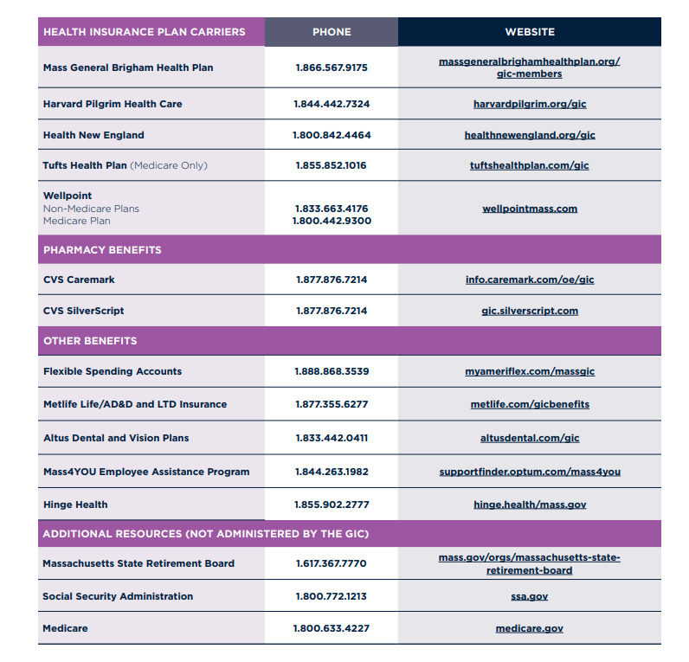
Carrier Contact Information
Contact your Health Insurance Carrier to: request member ID card(s), find a provider, tiered doctors and hospital lists, fitness and wellness programs offered, and offered tele-health options.
This list can be found on page 23 of the 2026–2027 BENEFITS GUIDE.
GIC Non-Medicare Health Plans | Mass.gov

Slide 14

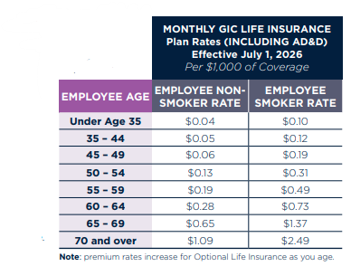
Optional Life Insurance
Life insurance helps provide for your beneficiary’s well-being in the event of a serious accident or death. This benefit is paid to your designated beneficiary(ies).
This is term insurance, which means it does not have
any cash surrender value.
Benefits are paid to your beneficiary(ies), so it is important to keep your beneficiary designation up to date.
Optional Life Insurance Non-Smoker Rate: State employees who have been tobacco-free are eligible for reduced nonsmoker optional life insurance rates effective July 1, 2026. *The smoker status can only be changed during the GIC’s Annual Enrollment period.

Slide 15

Optional Life Insurance- Cont.
You must be enrolled in basic life insurance in order to be eligible for optional life insurance. You can choose coverage between 1 to 8 times your salary. Rates are based on salary and age and will automatically increase as you age.
State employees actively at work may apply for the first time or apply to increase their coverage at any time during the year.
If you are applying for the first time, you will
receive instructions for completing a
medical insurability form for MetLife’s review and approval. The GIC will determine the effective date if MetLife approves your application.

Slide 16
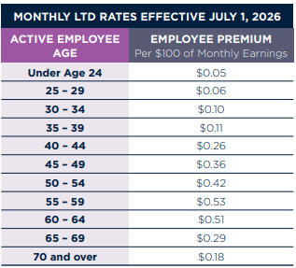
Long Term Disability
An income replacement program that financially protects you and your family in the event you become disabled and are unable to perform the material and substantial duties of your job.
If you are unable to work for 90 consecutive days due to illness or injury, this program provides income replacement.

Slide 17
Long Term Disability – Cont.
State employees actively at work may apply for the first time or apply to increase their coverage at any time during the year.
If you are applying for the first time, you will receive instructions for completing a medical insurability form for MetLife’s review and approval. The GIC will determine the effective date if MetLife approves your application.

Slide 18
Health Insurance Buy-Out
Under the Buy-Out plan, eligible state employees receive 25% of the full-cost monthly premium in lieu of health insurance benefits for one 12-month period. Employees receive the remittance monthly in their paychecks. The amount of payment depends on your health plan and coverage.
https://www.mass.gov/info-details/health-insurance-buy-out-program
There are two buy-out periods, and your reimbursement will be determined based on the GIC product you are enrolled in at the end of the covered period.
During Annual Enrollment, April 1, 2026 - May 1, 2026: If you were insured with the GIC on January 1, 2026, or before, and continue your coverage through June 30, 2026, you may apply to buy out your health plan coverage effective July 1, 2026. The deadline for submission is May 1, 2026*.
October 5, 2026 – October 30, 2026: If you are insured with the GIC on July 1, 2026, or before, and continue your coverage through December 31, 2026, you may apply to buy out your health plan coverage effective January 1, 2027. The deadline for submission is October 30, 2026*.
*Applications received after the deadlines for the buy-out periods will not be accepted. Employees must have access to other employer-sponsored coverage to be eligible.

Slide 19

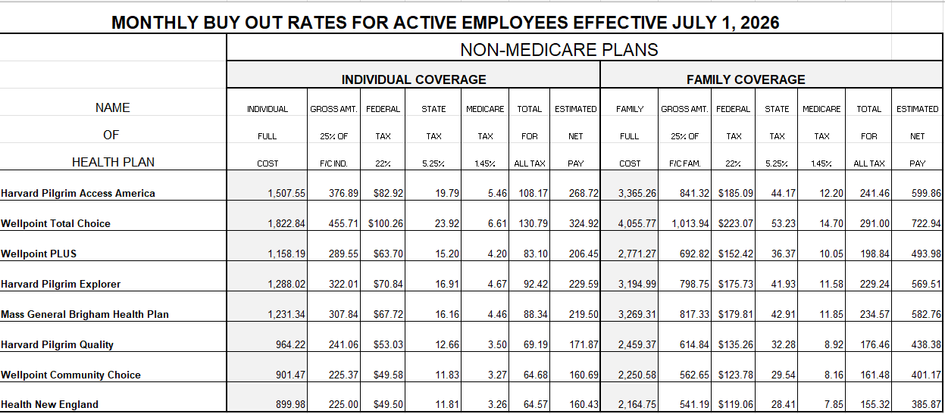
Buy Out Rates Effective July 1, 2026

Slide 20

Mass4YOU Employee Assistance Program (EAP)
Eligible to benefitted employees and up to (5) family members
Provides access to 24/7 confidential support that includes:
Eight free coaching sessions and three virtual, telephone, or
in-person therapy visits per issue, per year
30-minute telephone or in-person legal or mediation consultation per issue per year
Guidance from a financial coach to help with debt,
foreclosure, financial planning, and more
Referrals for a variety of Work-Life convenience services:
childcare, elder care and more
Access to Mass4YOU’s 24/7 confidential substance abuse
treatment helpline and a licensed clinician

Slide 21
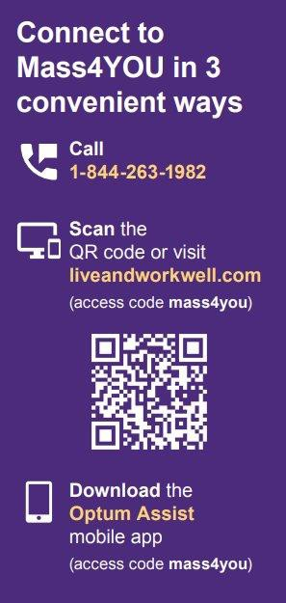
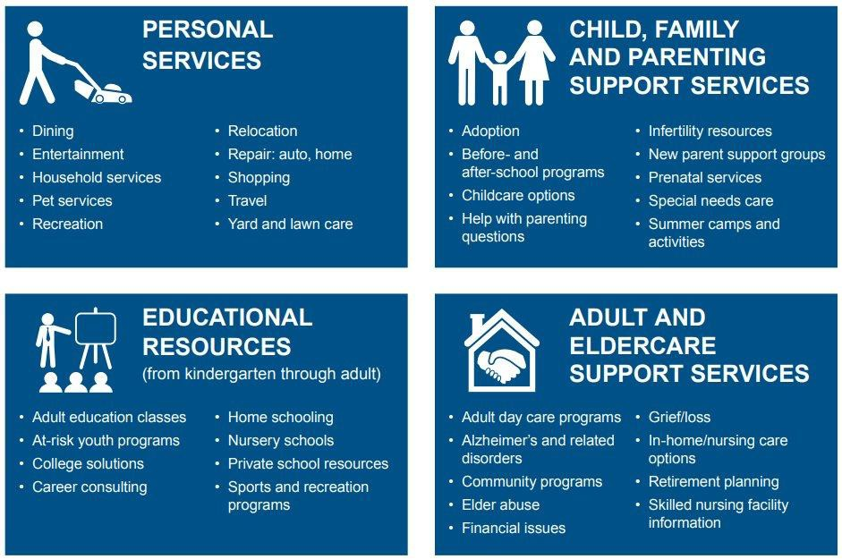
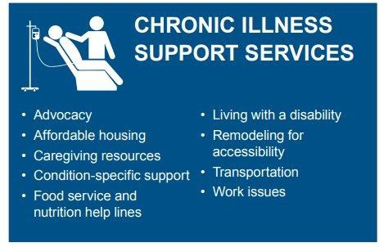
Get Support. Save Time. Enjoy Life.

Slide 22
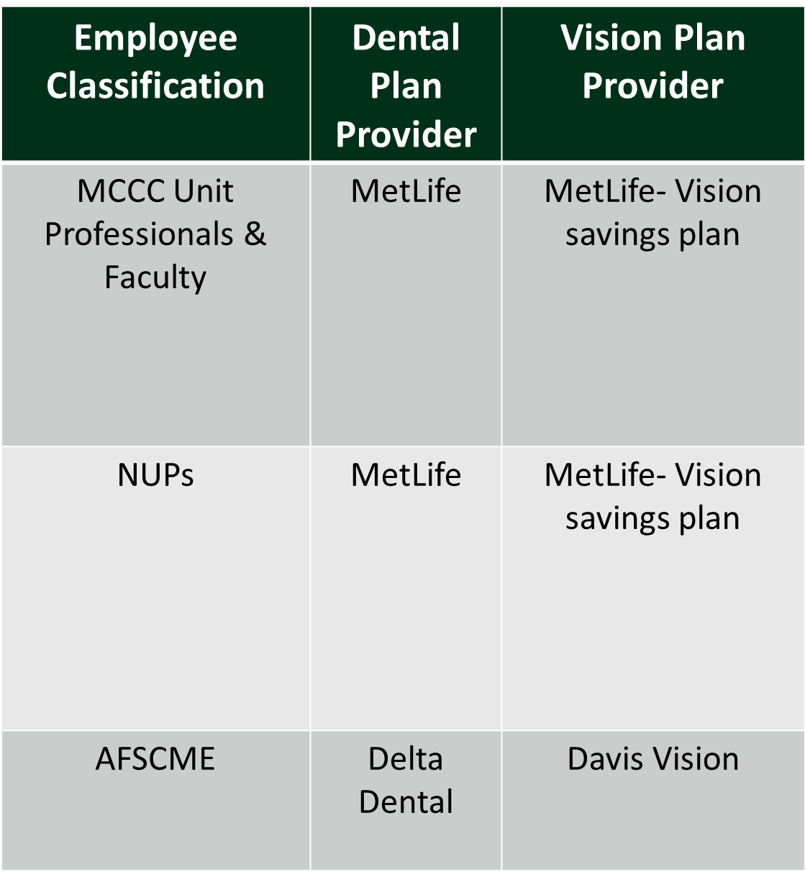
Dental and Vision
MCCC and NUP MetLife dental is administered Health Plans, Inc (HPI)
Member Log-In: BHE | Health Plans Inc. | Member Resource Center - My Plan Login
The Non-unit dental enrollment period occurs in October each year with a January 1 effective date.
AFSCME Delta Dental and Davis Vision is administered by the Massachusetts Public Employees Fund.
To learn more, visit: www.mpefund.org/

Slide 23
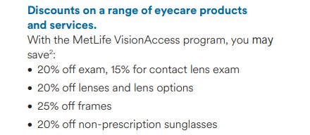
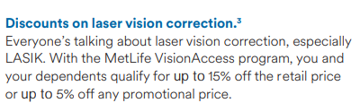
MCCC & NUP Vision Savings Plan
MCCC and Non-Unit Professionals are automatically enrolled in the MetLife VisionAccess Savings Plan
To receive your discounts just give the participating MetLife private practice provider your program code — MET2020
To see if your vision provider is a participant or to learn more, please visit: Vision Insurance |

Slide 24

Flexible Spending Accounts
Health Flexible Spending Account (HFSA): Min $250/Max $3,400 Dependent Care Account (DCA): Min $250/Max $7,500 per family
Enroll or re-enroll online at: https://myameriflex.com/massgic/
*This is the only benefit that must be re-enrolled in EACH year during
open enrollment.
Notes:
HFSA: Healthcare Flexible spending account: Covers medical expenses for you and your eligible dependents
DCA: Dependent care account FSA: can be used to pay for childcare
In exchange for the tax savings that these programs offer, the IRS imposes a use-it-or-lose-it rule. This means
that you must use all the money in your account by the end of the plan year, or you lose that money, subject to
the grace period.

Slide 25
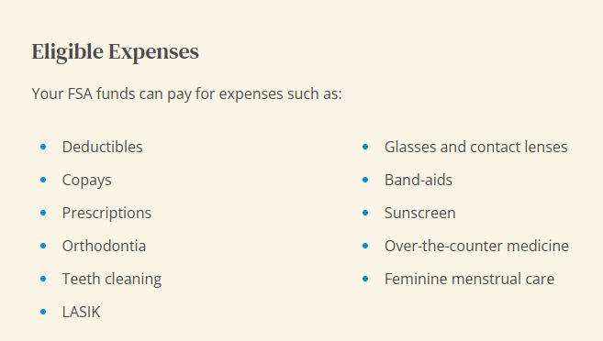
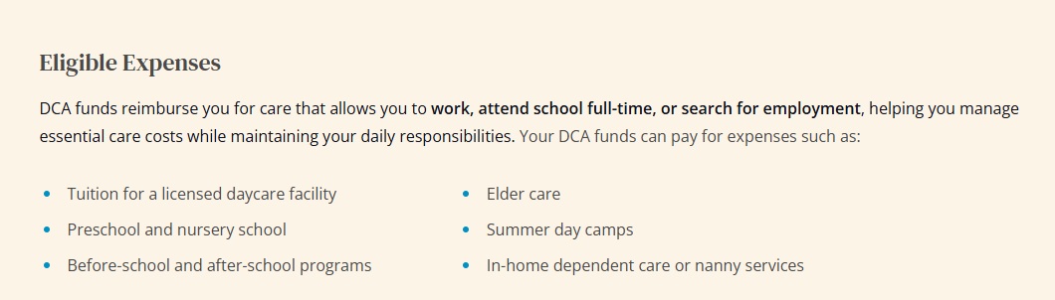
Flexible Spending Account Eligible Expenses
Comprehensive FSA Eligible Expenses List: What can I use my FSA or HSA for?
Comprehensive DCA Eligible Expenses List: What Can I Use my Dependent Care Account (DCA) For?

Slide 26

Leave Accruals
Non-Benefitted Employees
Sick
MCCC – by contract
Part time non-unit – 1 hour earned for every 30 hours worked to maximum of 40 hours per state law.
All Purpose Paid Leave (APPL)
MCCC unit professionals (part time, non-benefitted)
Hours worked over fiscal year earn APPL per contract
for use in the following fiscal year.
Benefited Employees earn:
Sick
Vacation (faculty do not accrue)
Personal
Comp (AFSCME & MCCC)

Slide 27
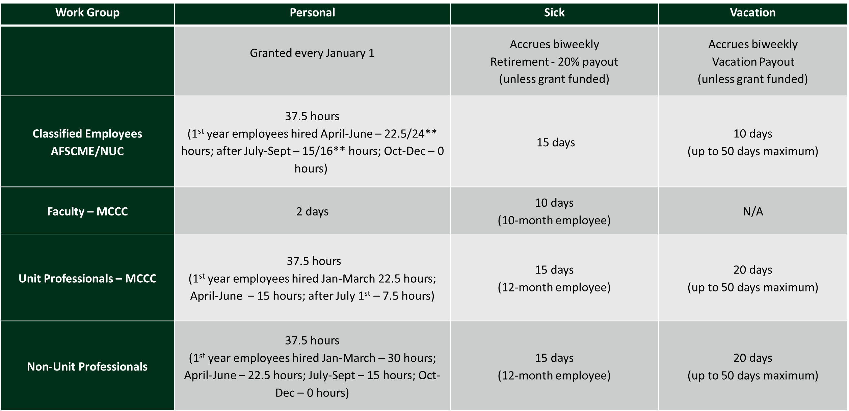
Benefited Leave Accrual Overview
*Maximum days

Slide 28
Tuition Remission
Tuition Benefit: Benefited employees and their spouses and dependents are eligible for tuition waiver at Bristol and tuition remission at other Massachusetts state colleges, universities, and UMass locations in accordance with applicable policies.
The remission per school may vary and is subject to change. Please contact your school of interest directly to confirm the current remission rates.
Tuition remission and wavier benefits are available to employees after 6 months of employment.
Adjunct Faculty :
Eligible for tuition waiver at Bristol Community College.
Must be teaching during the semester the waiver is being used.
Tuition Remission information and forms:
https://bristolcc.edu/bristolcommunity/facultystaff/humanresources/benefits/tuitionremission.html

Slide 29
Tuition Remission - Categorical Waivers
Part-time non-benefitted employees are not eligible for Tuition Remission unless they meet the
criteria for the specific groups below:
Wartime Veterans (Massachusetts residents only)
Active Duty Personnel
Senior Citizens (Massachusetts residents only, 60 plus yrs. old.)
Native Americans
Mass Commission for the Blind and Mass Rehab member
SACHEM Faculty, Staff and Students
Human Services Employee
National Guard
State Employee Waiver
For more information, go to the Bristol website at Categorical Waivers

Slide 30


COMPANY CODE: BRISTOLCC
ticketsatwork@info.ticketsatwork.com

Slide 31
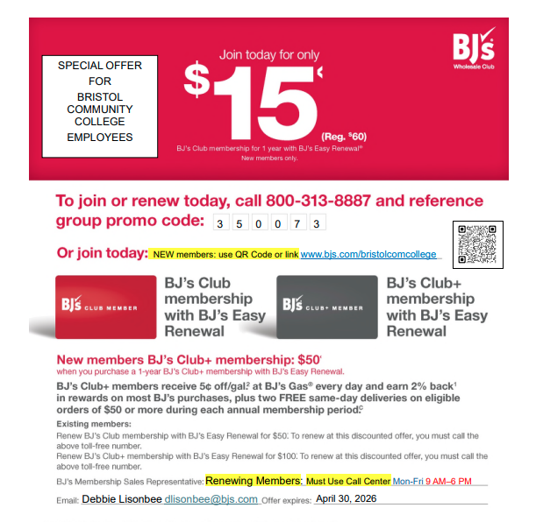
BJ’s Membership
BJ's semi-annual enrollment event for new and
existing members is
Effective now through April 30, 2026.
  All membership enrollments and renewals are processed through the BJ's Partnership Support Center. To enroll or renew your membership, please call the support center at the contact information listed below:
BJ’s Partnership Support Center
  Phone #: 800-313-8887
  Hours of Operation: Monday-Friday from 9:00 AM -
6:00 PM EST

Slide 32
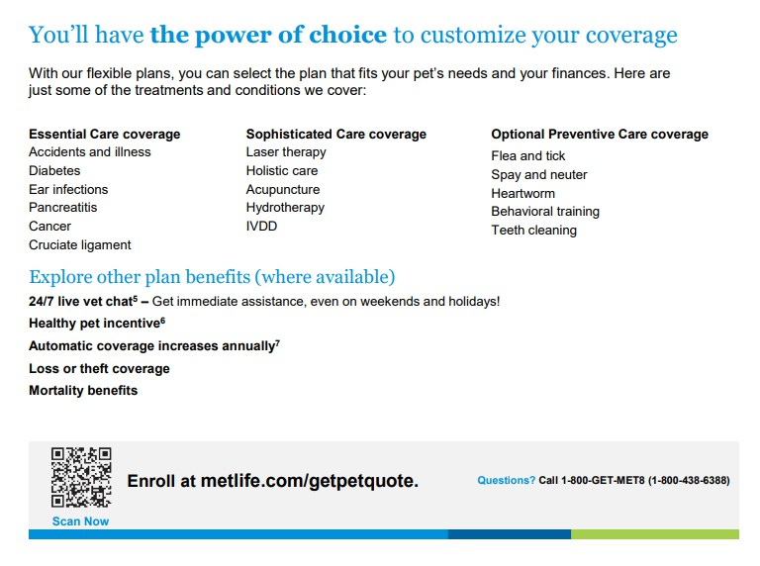
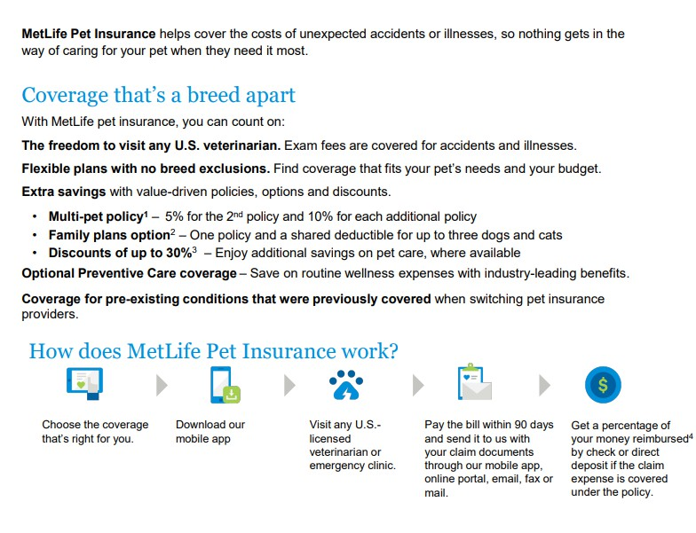
NUP Additional Benefits
Optional Pet Insurance through MetLife

Slide 33
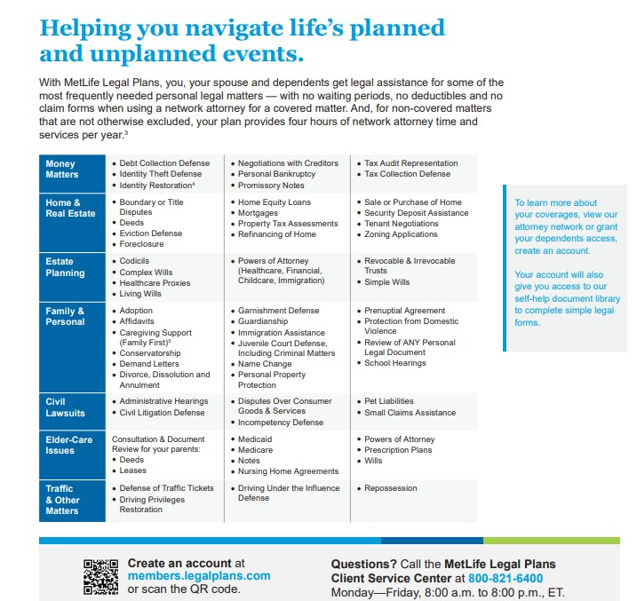
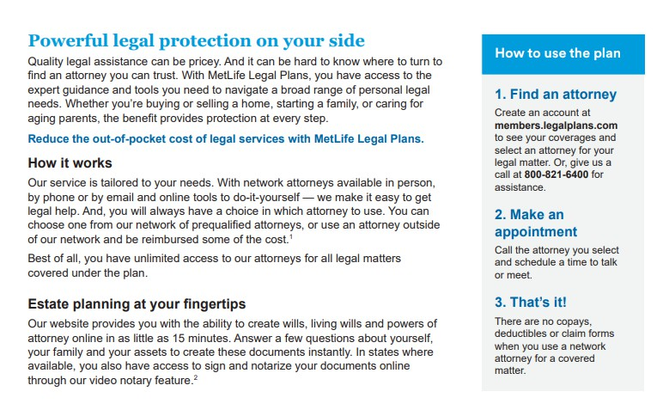
NUP Additional Benefits Cont.
MetLife Legal Plans

Slide 34

Questions?

Slide 35



​
Alicia Lewis​
Strategy Manager, Employee Wellness
Contact: alicia.lewis@bristolcc.edu X2514
Pamela Legg
Director, Employee Services
Contact: pamela.legg@bristolcc.edu X2194
Notes:
Thank you for watching human resources leave of absence training.
For more information regarding leave of absence please reach out to Alicia Lewis our Strategy Manager, or employee wellness or Pamela Legg the Director of Employee Services.

